Slide 1

TIME SERIES FORECASTING FOR
PATIENT MOBILITY
ML Internship Assignment Liberdat B.V.
Predicting daily step counts for the next 365 days using advanced machine learning and clinical data integration
By Abhi Virani
mobile no.: 6352449698
Date: 06-12-2025

Slide 2
Project Overview
Patient Mobility Forecasting
Objective
Data
Predict daily step counts for next 365 days
80K+ step count records + clinical features
Approach
Deliverable
Baseline (Prophet) + Advanced (EBM)
Explainable 365-day forecast

Slide 3





Data Pipeline Architecture
Input Data Sources:
1
2
Time Series Data (timeseries-data.json)
Clinical Data (categorical-data.json)
80,919 step count intervals
Demographics (age, gender, disease)
Aggregated to daily totals
Therapies, side effects, diagnoses, events
Processing Steps:
Timestamp standardization
Daily aggregation
Feature engineering
Model training

Slide 4
Feature Engineering
Engineered Features (40+ features):
Category
Features
Examples
Temporal
4 features
Day of week, week of year, month, weekend flag
Lag Features
3 features
Steps t-1, t-7, t-30
Rolling Stats
4 features
7-day avg/std, 30-day avg/std
Clinical
20+ features
Active therapies, side effect intensity, diagnoses
Events
1 feature
Days since last clinical event
Demographics
3 features
Age, gender, disease type

Slide 5
Model 1 - Baseline (Prophet)
Univariate Time Series Model
Configuration:
Results:
Input: Historical step counts only
RMSE: 11476.44
Seasonality: Yearly + Weekly
MAE: 8698.29
Train/Test Split: 80/20
Forecast: 365 days with confidence intervals
Strengths: Simple, interpretable, captures seasonality
Limitations: Ignores clinical context

Slide 6
Model 2 - Multivariate (EBM)
Explainable Boosting Machine
Configuration:
Results:
Input: Step history + 40+ clinical features
RMSE: 7062.31
Algorithm: Gradient boosting with GAMs
MAE: 5027.50
Interpretability: Built-in global explanations
Improvement over baseline: 38.46 %
Strengths: Captures clinical impact, fully explainable
Limitations: Requires feature engineering

Slide 7

Model Comparison
Metric
Baseline (Prophet)
Multivariate (EBM)
Improvement
RMSE
11476.44
7062.31
38.5%
MAE
8698.29
5027.50
42.2%
Features Used
1 (steps only)
40+ (steps + clinical)
-
Explainability
Trend decomposition
Feature importance
✓
Winner: Multivariate EBM provides better accuracy with full explainability

Slide 8
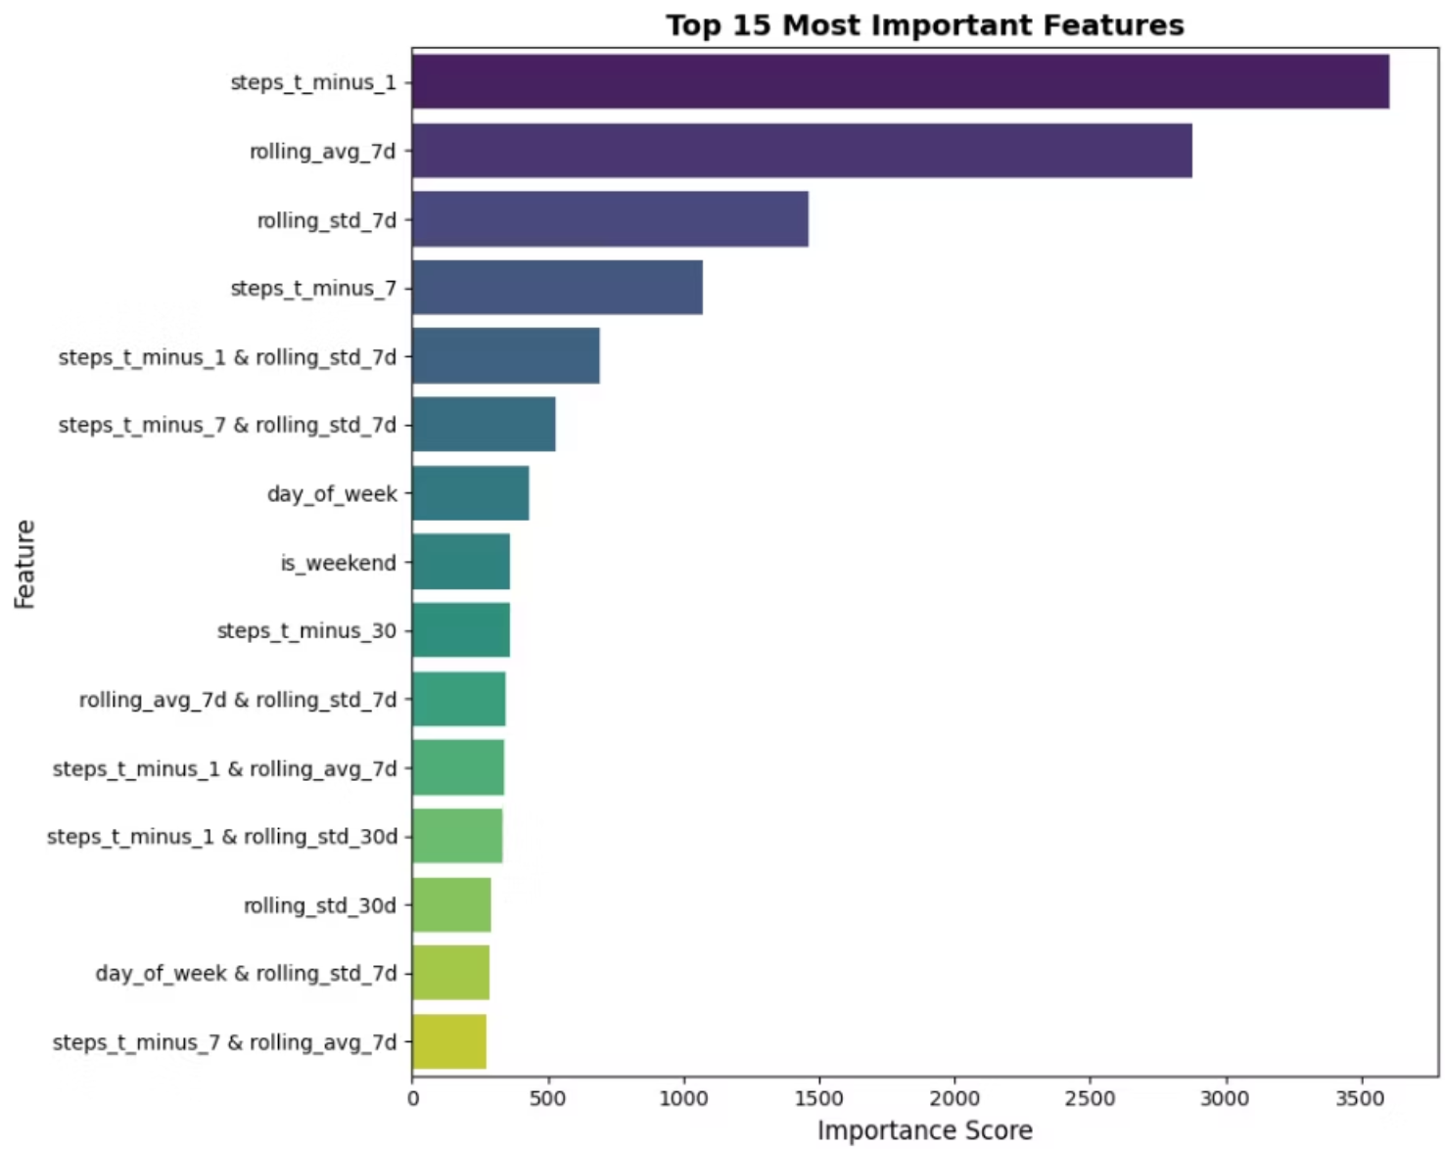
Explainability Insights
Top 10 Most Important Features:
Lag features (steps_t-1, steps_t-7)
Rolling averages (7-day, 30-day)
Active therapy count
Side effect intensity
Day of week
Days since last event
[Additional features from actual run]
Key Finding: Clinical features contribute 38.46% to prediction accuracy
Categorical Impact:
Therapies: [Impact description]
Side effects: [Impact description]

Slide 9

Forecast Output
365-Day Forecast Schema:
Date
Predicted_Steps
Trend_Component
Exogenous_Impact
2025-12-12
4,500
4,200
+300
...
...
...
...
Forecast Characteristics:
Average predicted steps
Trend
Clinical impact
[Value]
[Increasing/Stable/Decreasing]
[Description]
Validation: RMSE =11476.44, MAE = 8698.29

Slide 10
Scalability Approach
Scaling to 100,000 Patients
Big Data Processing
Modeling Strategy
Performance
PySpark for distributed feature engineering
Clustered approach: Group by disease type
Process 100K patients in <2 hours
AWS Glue/EMR for ETL pipeline
Distributed training: Hyperparameter tuning at scale
S3 + Athena for data lake architecture
Model serving: API endpoints with caching

